Slide 1
Autonomous Vacuum Cleaner Robot
Biruk Berhanu
Advisor: Mr. Kinde Mekuria

Slide 2
Overview
Introduction
Background
Problem statement
Objectives
Methodology
Mathematical Modeling
Odometry
Control System Design
Simulation/Design
Result and Discussion
Conclusion
Future Work

Slide 3
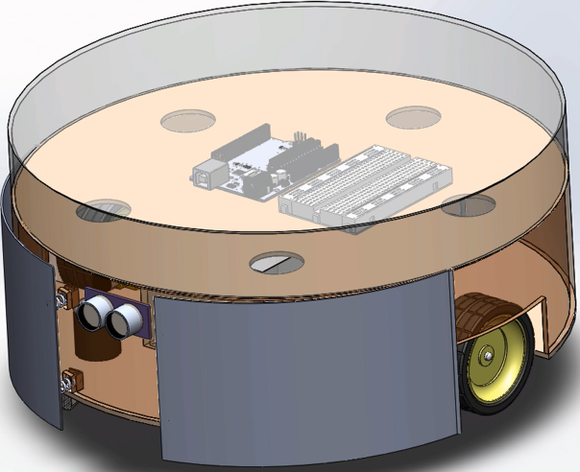
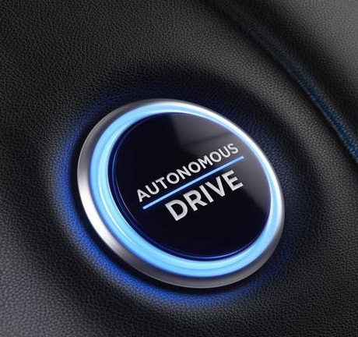
Introduction
It uses vacuum to clean dirt
It navigates both autonomously and manually
Can be Implemented at low cost using readily
available material

Slide 4
Introduction Cont’d
Theoretical Background
Mathematical Modeling
Control Theory
Sensing
localization
Mapping
Path Planning

Slide 5
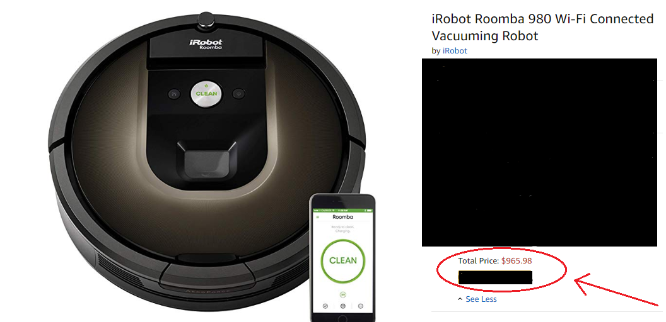
Background
Roomba is one of the most widely used vacuum cleaning robots
Other brand costs
between $400-$900

Slide 6
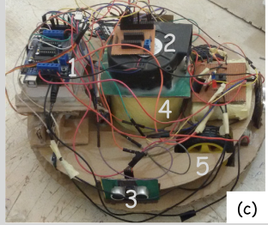
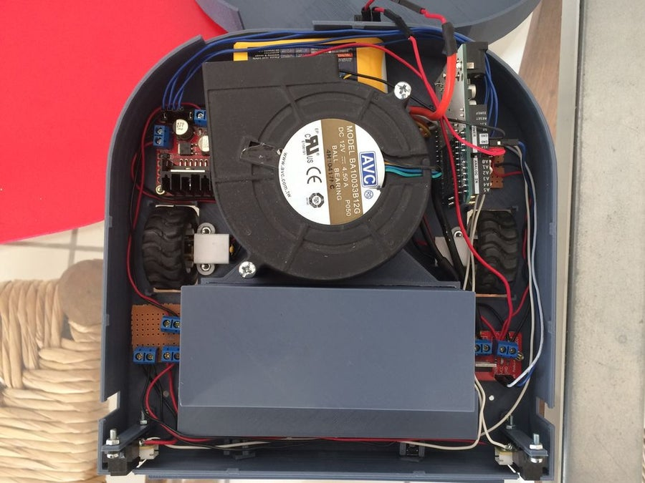
Background Cont’d
T.B. Asafa, T.M. Afonja, E.A. Olaniyan, H.O. Alade October
2016 Ladoke Akintola University of Technology, Nigeria
CesNieto : https://www.instructables.com/id/Build-Your-Own-Vacuum-Robot/

Slide 7

Problem statement
Price of the vacuum cleaner in the market
The research made in university and technology enthusiast
Big in size
Low vacuum cleaning power
Inefficient algorithm for navigation

Slide 8

Objectives
Low Price
Efficient navigation
Small in Size
Power efficient

Slide 9
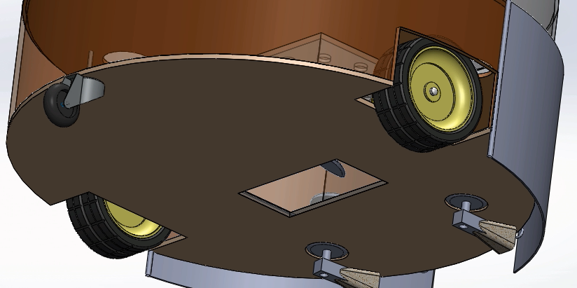
Methodology
Driving Mechanism
Two DC motor controlled wheel
One caster wheel for balancing
at the bottom rear

Slide 10
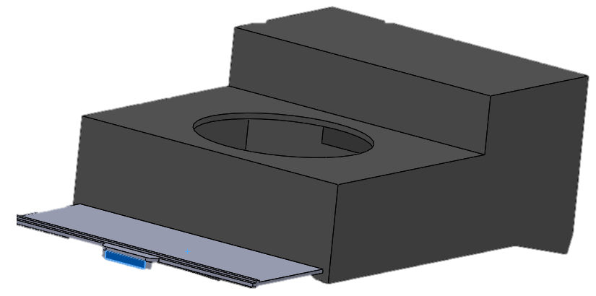
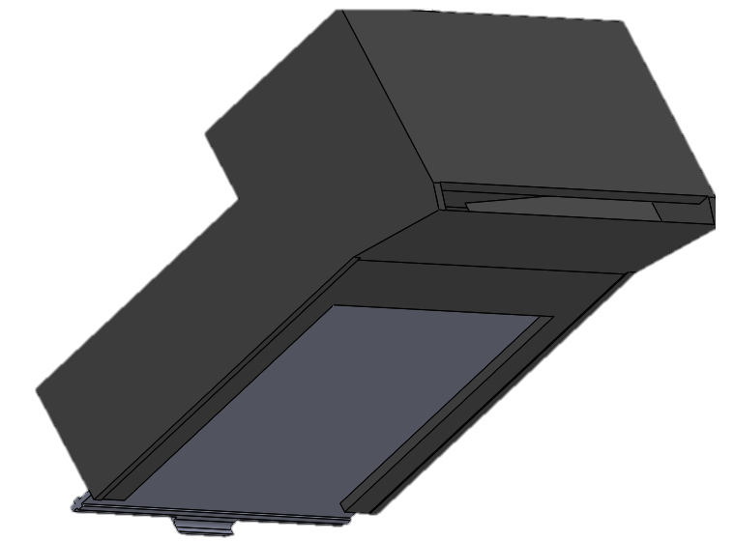
Methodology Cont’d
Cleaning Mechanism
One DC-motor driven for creating
a vacuum region
One DC-motor driven sweeper

Slide 11
Methodology Cont’d
Navigation
Two mode of operation
Autonomously
Manually using Web
Random Walk
The robot navigates freely
without any control.

Slide 12
Methodology Cont’d
Controlled path(Method 1)
The robot moves only
orthogonally to the wall
uses the whole room as
one rectangle

Slide 13

Methodology Cont’d
Controlled path(Method 2)
Divide the house into numbers
of rectangles

Slide 14

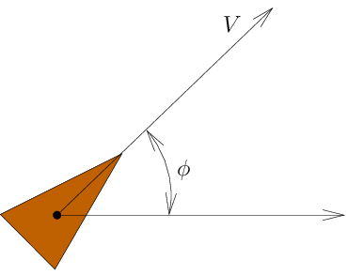
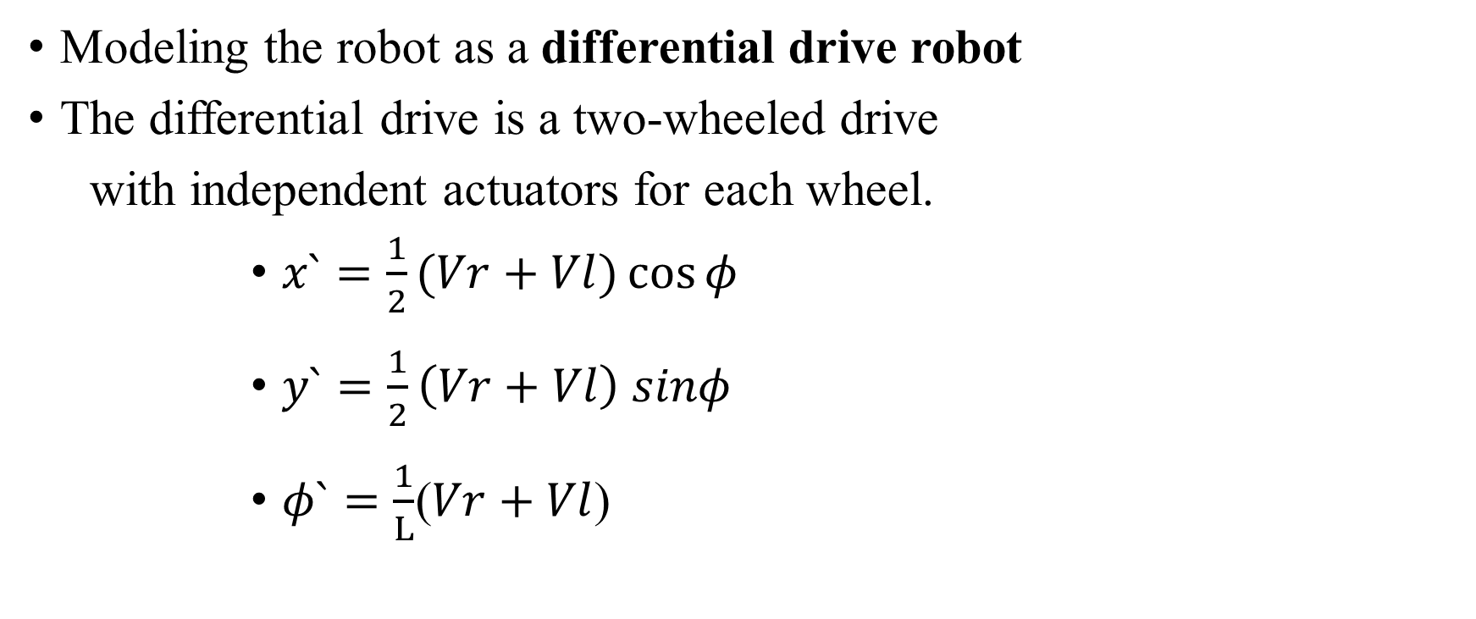
Mathematical Modeling
Modeling the robot as a differential drive robot
The differential drive is a two-wheeled drive
with independent actuators for each wheel.
$x`=\frac{1}{2}(Vr+Vl)\cos{φ}$
$y`=\frac{1}{2}\left(Vr+Vl\right) sinφ$
$φ`=\frac{1}{L}$($Vr+Vl$)
L

Slide 15
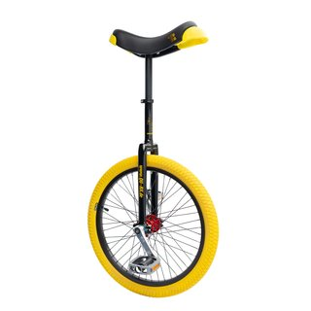

Mathematical Modeling Cont’d
Simplification to the modeling
- Using Unicycle Modeling
$x`=V\cos{φ}$
$y`=Vsinφ$
$φ`=ω$

Slide 16
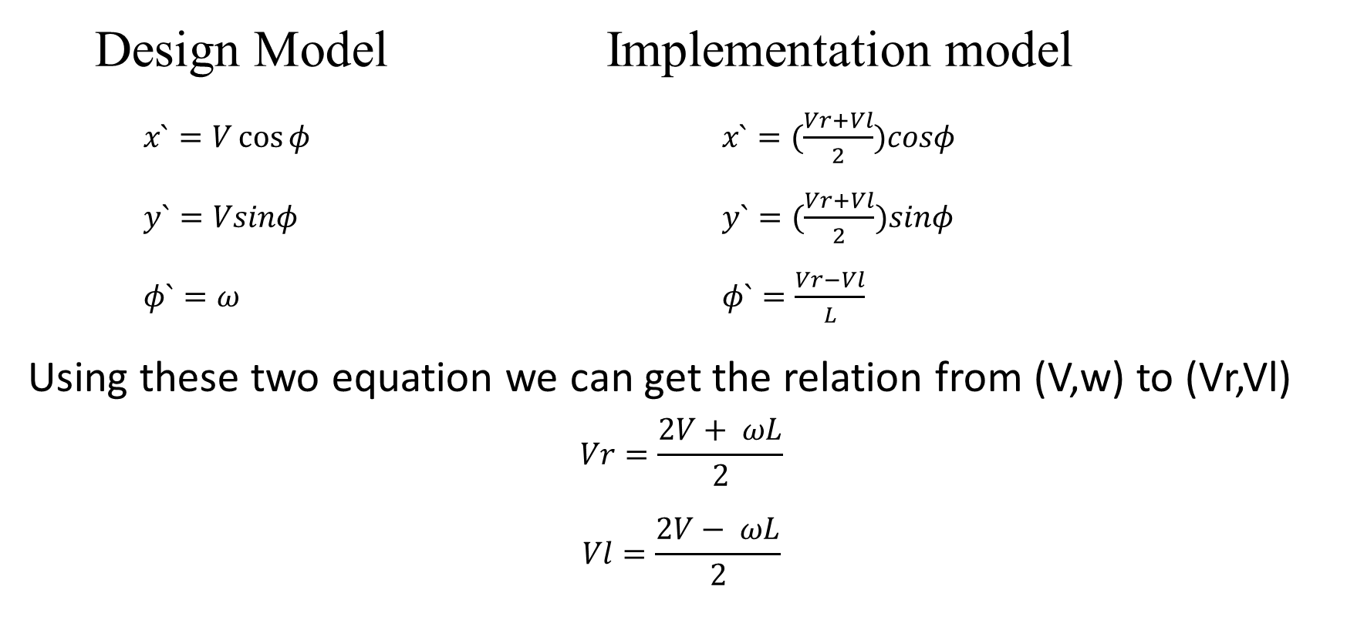
Mathematical Modeling Cont’d
Design Model Implementation model
$x`=V\cos{φ}$ $x`=(\frac{Vr+Vl}{2})cosφ$
$y`=Vsinφ$ $y`=(\frac{Vr+Vl}{2})sinφ$
$φ`=ω$ $φ`=\frac{Vr−Vl}{L}$
Using these two equation we can get the relation from (V,w) to (Vr,Vl)
$$Vr=\frac{2V+ ωL}{2}$$
$$Vl=\frac{2V− ωL}{2}$$

Slide 17
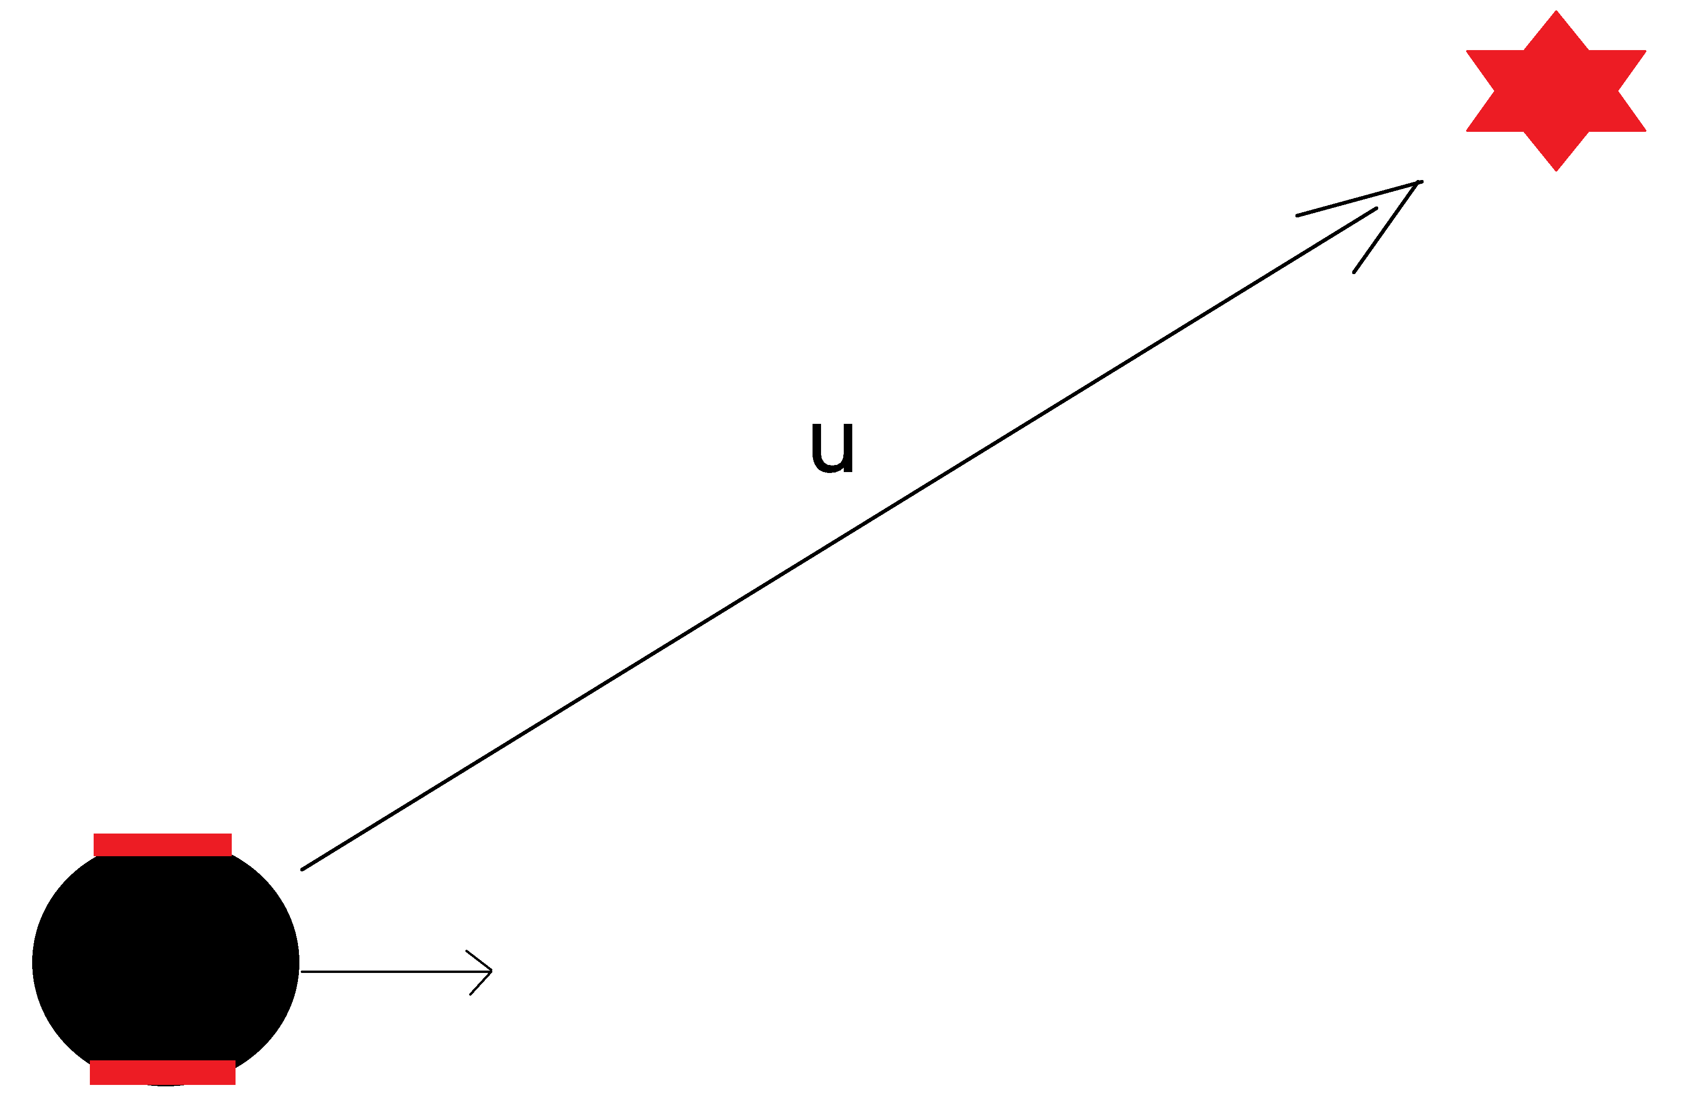

Mathematical Modeling Cont’d
Even though the Unicycle modeling makes a simplification to our work, It is still not convenient for solving path planning problem
High Level Modeling
p$`=u, x∊$ R²
$u=\left[u_{x},u_{y}\right]$
$$x`=[x_{1},y_{1}]$$

Slide 18

Mathematical Modeling Cont’d
$φ_{d}=atan⁡(\frac{u_{y}}{u_{x}})$
$V= \sqrt{u_{y}+u_{x}}$
$ω=PID\left(e\right)=K_{p}e+ K_{i}\int_{0}^{τ}{e\left(t\right)dτ}+\frac{K_{d}e\left(t\right)}{dt}$ $e= φ_{d}− φ$

Slide 19
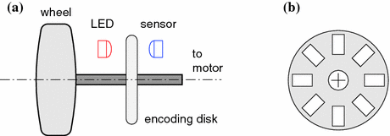
Odometry
where am I ?
Where am I heading ?
Ans: Wheel encoder ( both for heading and position )

Slide 20

Odometry Cont’d
$$x`=x+d_{center}\cos{Θ}$$
$$y`=y+d_{center}\sin{Θ}$$
$$Θ`= Θ+ φ$$
$$φ= {(d}_{right}−d_{left})/L$$

Slide 21

Odometry Cont’d
How do we calculate dr, dl ?
Ans:
D = 2$π$R(Δtick /N)
Where R is radius,
N is number of opening slots in the encoding disk,
D is either dl or dr with a respective Δtick,

Slide 22
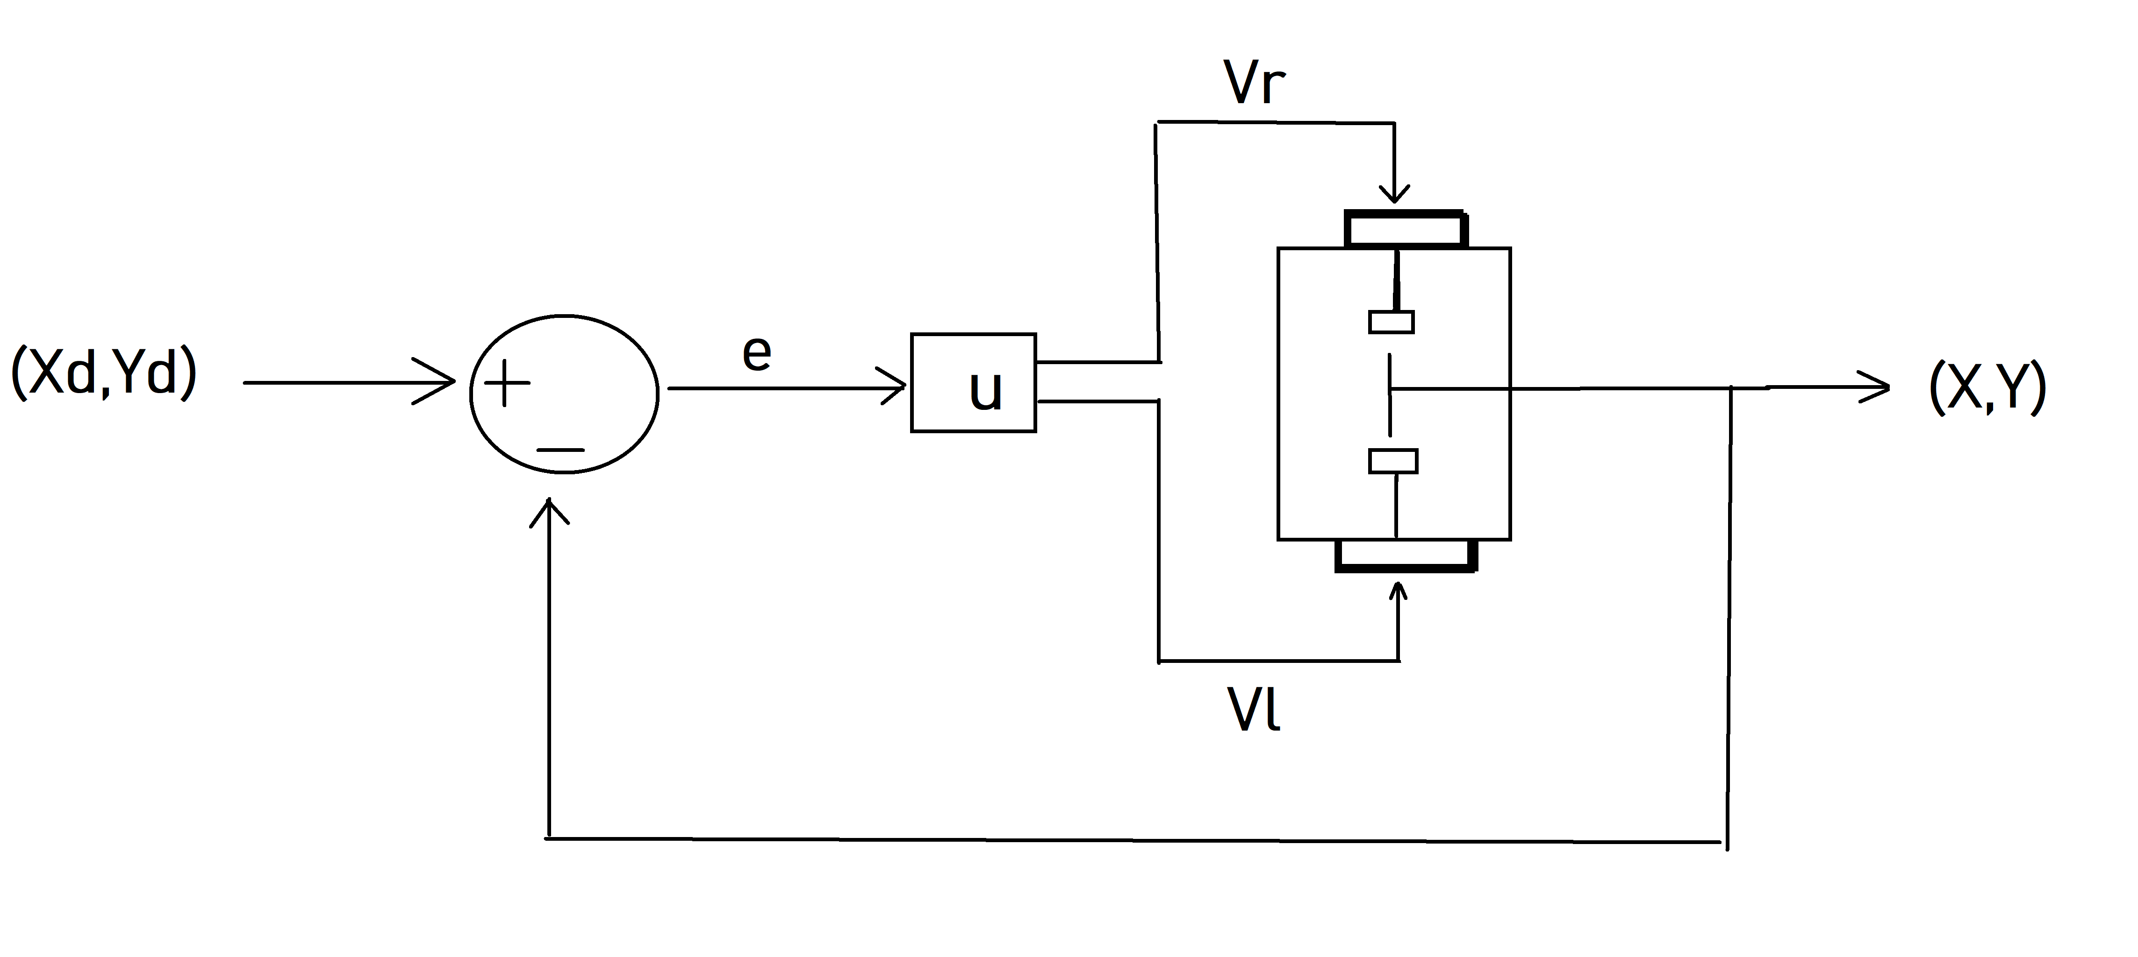
Control System Design
I used PID controller for controlling the motion of the robot.

Slide 23
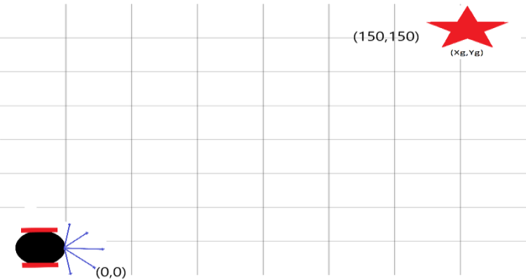
Result
Go To Goal Behavior
With PID parameters of
Kp = 2
Ki = 0.05
Kd = 0

Slide 24
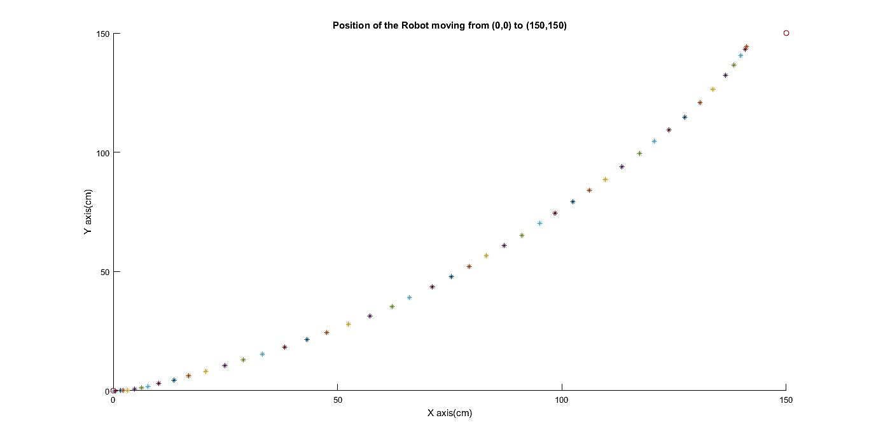
Result cont’d (Go To Goal Behavior)
Position of the robot

Slide 25
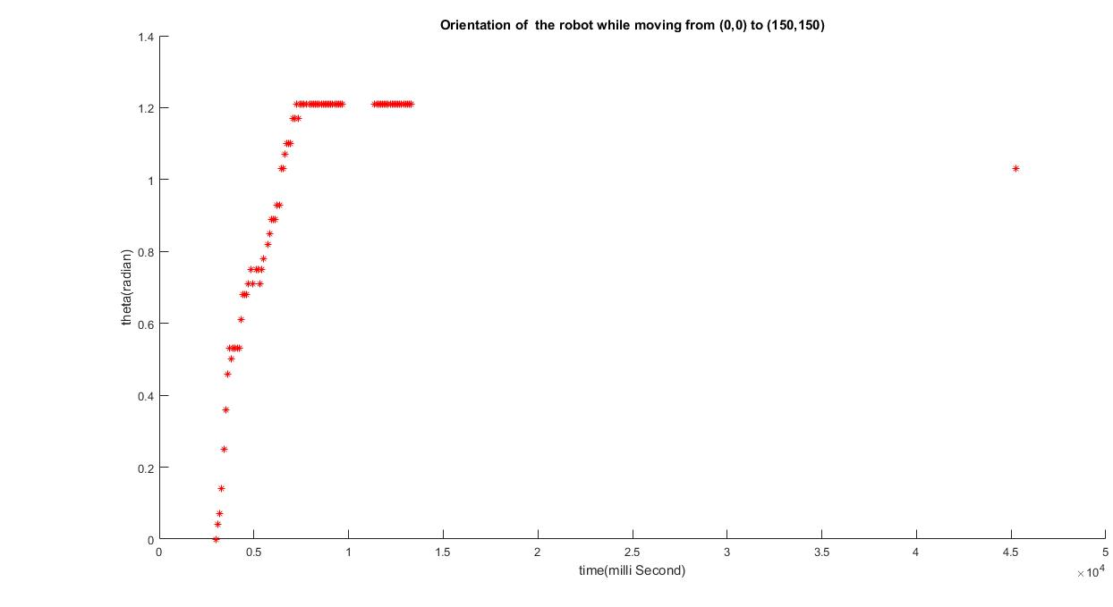
Result cont’d (Go To Goal Behavior)
Tracking of the angle response

Slide 26
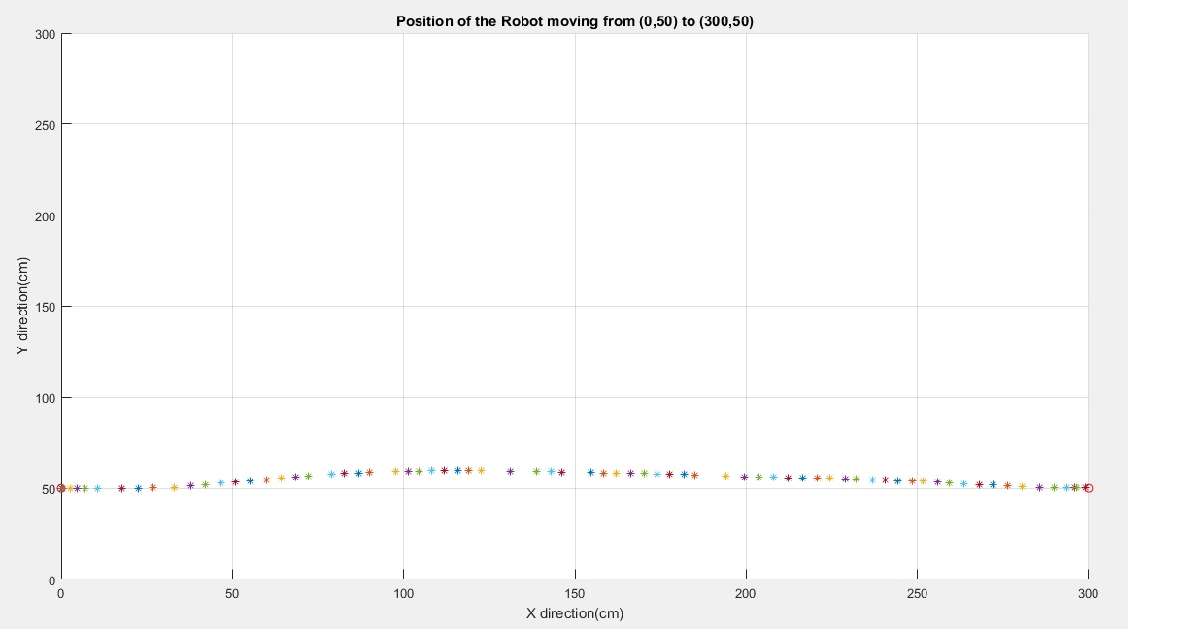
Result cont’d (Go To Goal Behavior)
Robot moving a straight line from position from x = 50 and y = 0 to goal position x = 300, and y = 0, with PID parameter of Kp = 20, Ki = 10, Kd = 5

Slide 27
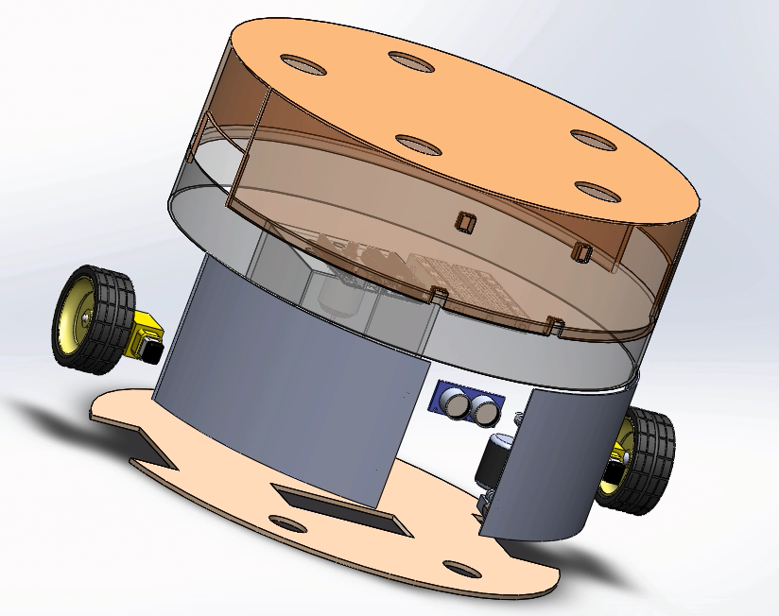
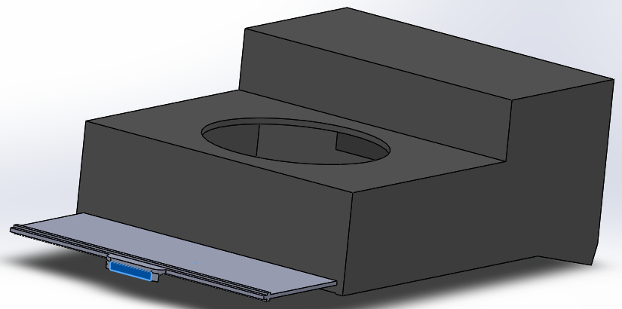
Result ( Hardware design )

Slide 28
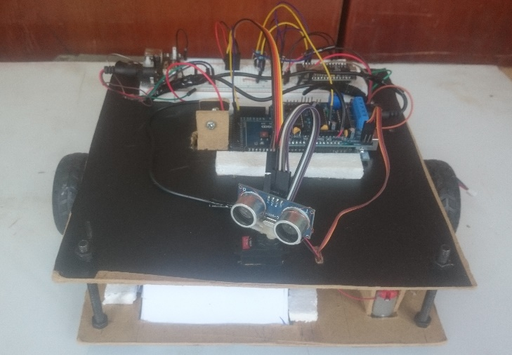
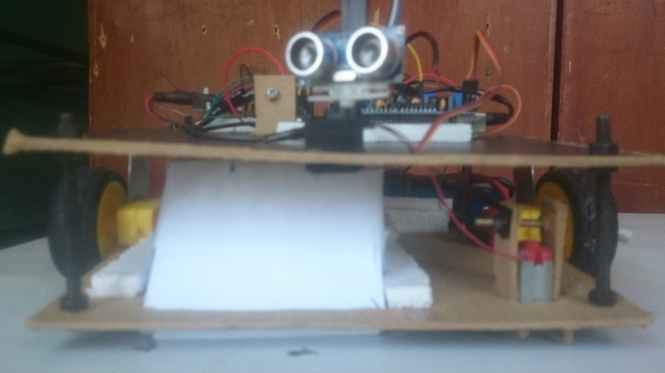
Result ( Hardware Model )

Slide 29
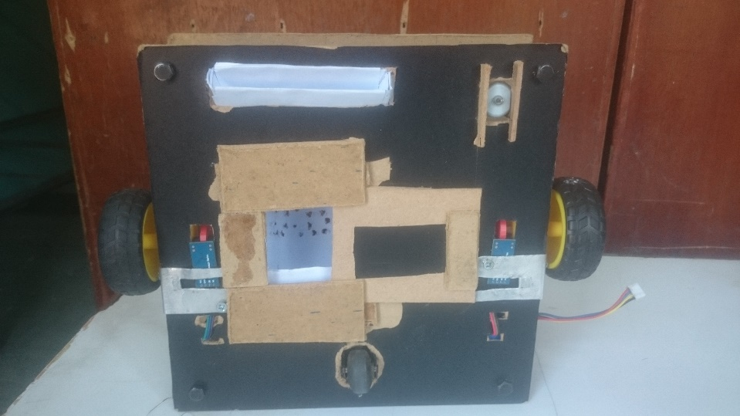
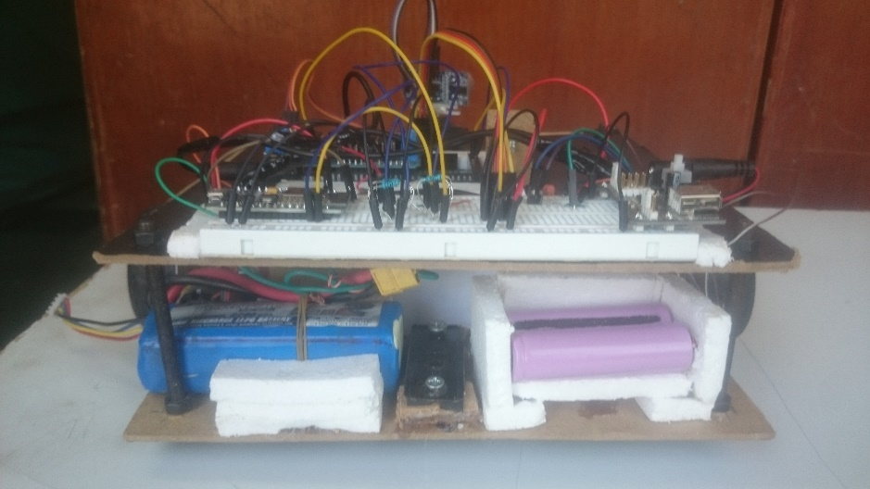
Result (Hardware Model)

Slide 30
Conclusion
Satisfactory result on Odometry and Go-To-Goal behavior
Have most of the features of a conventional vacuum cleaner
Very challenging building a fully functional mobile robot by homemade material, I advice to use quality products.

Slide 31
Future work
SLAM( Simultaneous Localization And Mapping)
Need high computational power processor. (at least raspberry pi)
Need a LiDAR sensor
Docking station for charging and position recalibration
Application for managing its various feature
Security
Different power usage mode

Slide 32


